Slide 1
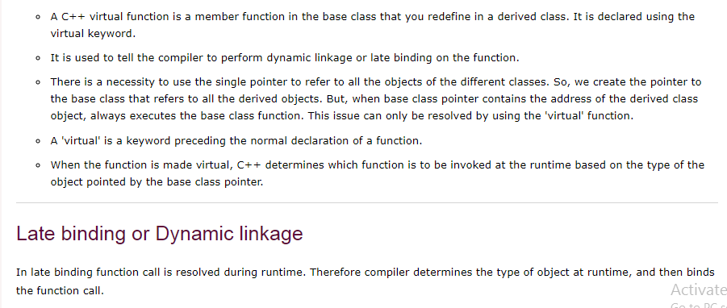

Slide 2
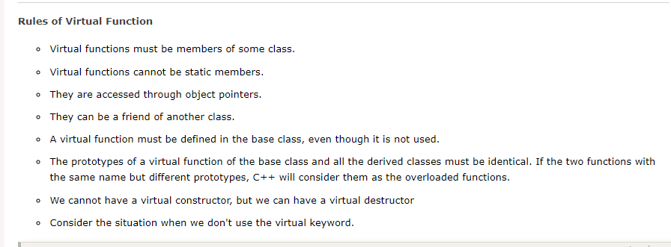

Slide 3
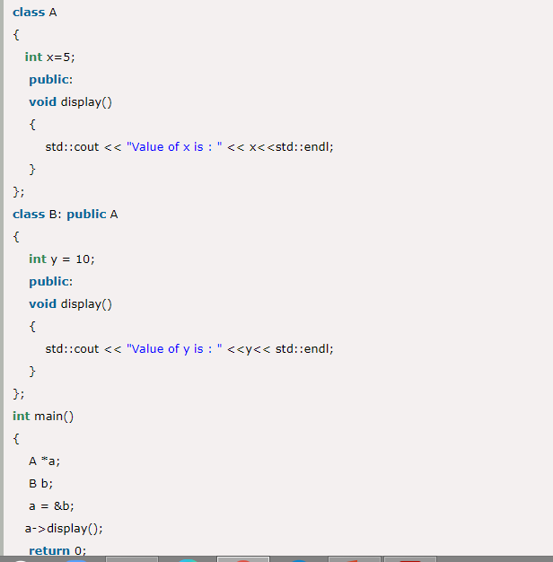

Slide 4
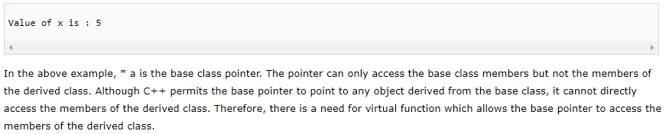

Slide 5
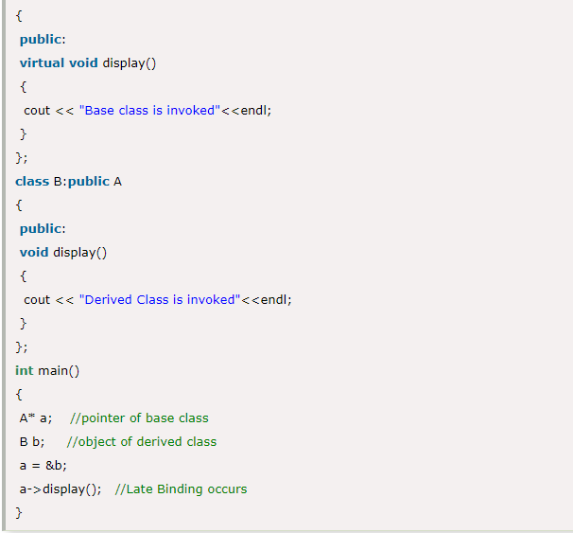

Slide 6
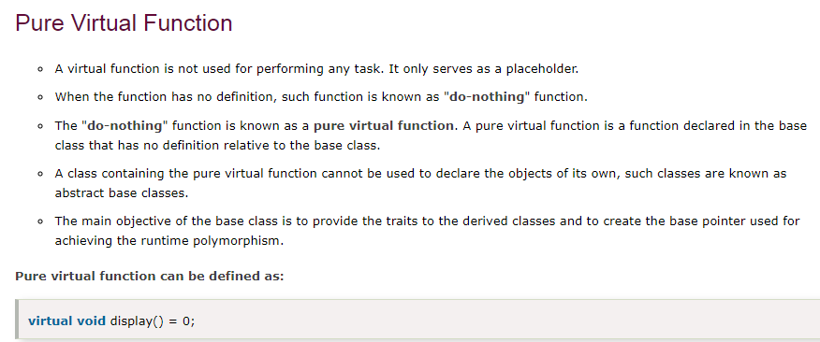

Slide 7
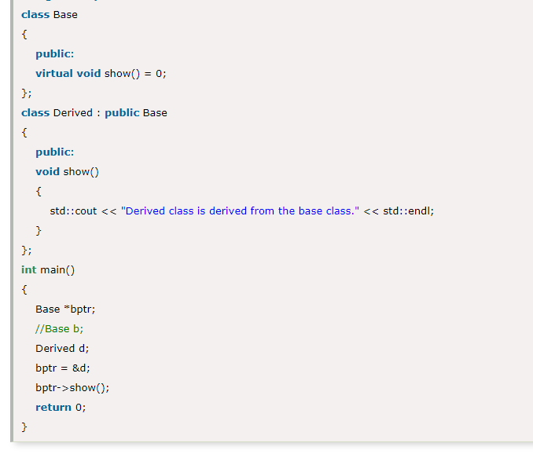

Slide 8
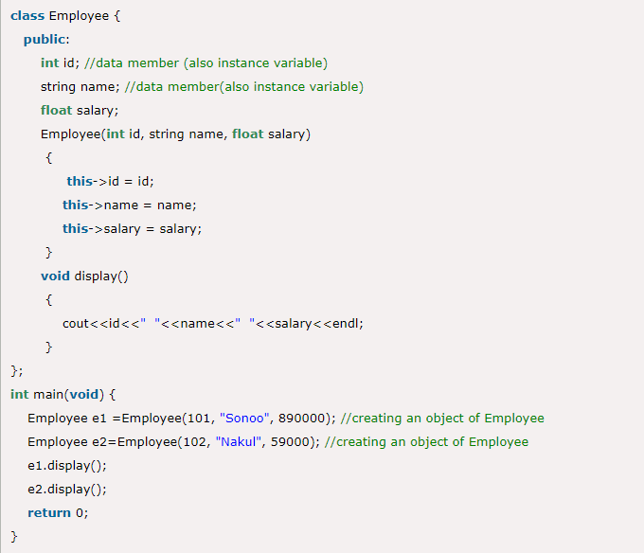

Slide 9
……………. binding means that an object is bound to its function call at compile time. A) Early B) recursive C) dynamic D) fixed

Slide 10
C++ supports run time polymorphism with the help of virtual functions, which is called …………….. binding. A) recursive B) run time C) early binding D)static

Slide 11
The …………………. cannot be directly used to access all the members of the derived class. A) void pointers B) null pointers C) this pointer D) base pointer

Slide 12
If a ……………………… is defined in the base class, it need not be necessarily redefined in the derived class. A) member function B) virtual function C) static function D) real function

